Slide 1
Adam Atanas Phys401 – Dr. Reiff April 13, 2009
Ham Radio in Space

Slide 2
Ham Radio is Beneficial in Space
Ham radio, first put into outer space by W5LFL in 1983, has now become a fun, educational tool for teachers and hams alike to use.
It has become so useful in outer space that ARISS was founded in 1996 to put amateur radios on the ISS, and it has become a magnificent success.

Slide 3
The 1st Ham Radio in Space
Owen Garriott, W5LFL was the first person to carry a ham radio into space.
He tried to get a ham radio on the earlier Skylab mission, but NASA rejected it because it was too late in the development of the program.
With the help of ARRL (the American Radio Relay League) and AMSAT (the Amateur Radio Satellite Corporation), ham radio was finally allowed in STS-9 in 1983. W5LFL was allowed to bring 2 HTs, one as a spare.
W5LFL was limited to 1hr/day on the air—he could not interfere with mission activities.

Slide 4
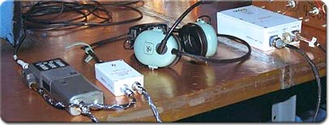
Ham Radio on the ISS
This is a photo of the initial radio station amateur equipment while it was being tested. After testing, the equipment was stowed aboard space shuttle Atlantis for delivery to the international space station during STS-106.
http://spaceflight1.nasa.gov/station/reference/radio/

Slide 5
W5KWQ, the Son of W5LFL
Richard Garriott, son of Owen Garriott, was aboard the ISS in October 2008 and made many QSOs with amateur radio operators and schoolchildren.
Because amateur radio operators’ favorite QSL cards are those from outer space, all hams that got a contact (too bad most of us weren’t hams then!) are extremely grateful he decided to go on the air.
He’s giving a talk on May 15 at the AMSAT/ TAPR Banquet during Hamvention 2009 in Dayton, Ohio.

Slide 6
The Formation of ARISS
ARISS (Amateur Radio on the International Space Station) was founded in 1996 when delegates from major radio corporations, including AMSAT, signed a Memorandum of Understanding to form ARISS.
Their Memorandum also formed the ISS Ham team.
It helps eliminate all of the technicalities of the ham radios aboard the ISS.

Slide 7
ARISS-Ham Radio on the ISS
Through ARISS (Amateur Radio on the ISS), hams from around the country can listen (and sometimes even talk) to the astronauts aboard the ISS.
Of course, astronauts cannot spend all of their time talking on the radio…unless they happen to be tourists!
A tourist, Charles Simonyi, is going to the ISS relatively soon—in May 27, even though he already went in March 26 (he’s a billionaire).

Slide 8
ARISS and Education
Through ARISS, schools can contact the ISS. When they do, the students can learn what life in space is like via questions. This will boost their interest in science, and we need more scientists.
It will also get more people to want to be a ham… which we also want!

Slide 9
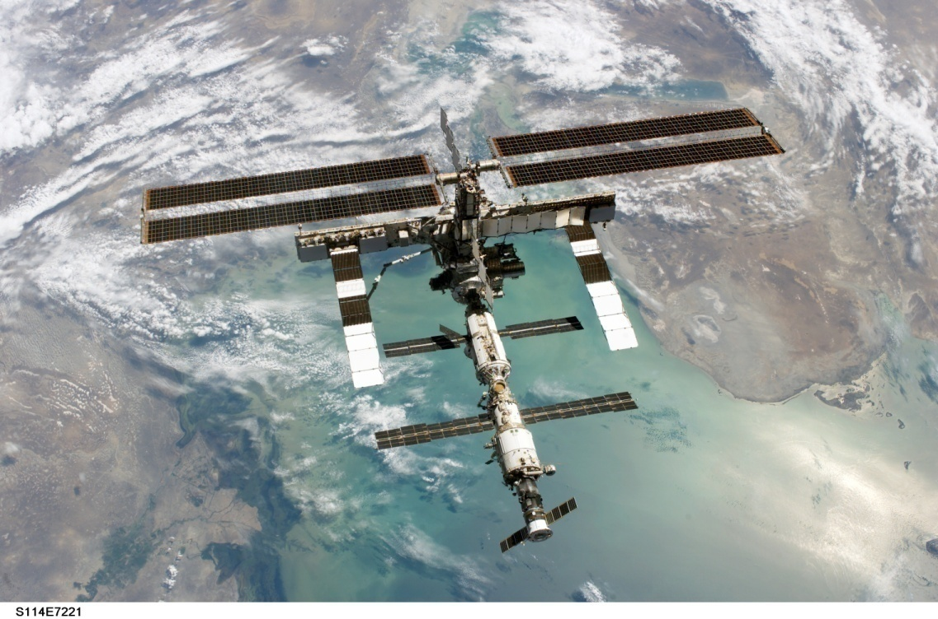
The ISS
Next time you hear news about the ISS being up tonight, try to contact it (if the astronauts aren’t busy!) But hurry– it’s only up for 4 minutes.
Backdropped against the Caspian Sea, this full view of the international space station was photographed by a crewmember onboard the Space Shuttle Discovery after the undocking of the two spacecraft. Image credit: NASA
http://www.nasa.gov/mission_pages/station/main/s114e7221_feature.html

Slide 10


Slide 11
Space Suit with Transmitter
Tune to 145.990MHz (the mode is FM )– Space suit w/ ham radio transmitter.
Thrown into orbit 4/7/2009 by the ISS. Packed w/ transmitter+ 3 batteries
Will burn up in Earth’s atmosphere
Packed with old clothes to look like a real person.
It relays a secret message.

Slide 12
It’s Good for Both Sides
Ham radio can make astronauts feel more at home when they’re on the ISS.
Ham radio is fun, which might outweigh the feeling of homesickness.
Hams on the ground jump at the chance to receive a CQ from outer space.
Lots of hams are probably tuning 145.990—there’s a space suit on that frequency.
So listen to that spacesuit and contact the ISS.

Slide 13
Citations
AMSAT. AMSAT-Dayton Hamvention 2009. 6 March 2009. 12 April 2009 <http://www.amsat.org/amsat-new/hamvention/2009/Dayton.php>.
ARRL. ARRL Web: Ham Radio Lets ISS Crew Members Connect with Schools Around the World. 18 April 2007. 9 April 2009 <http://www.arrl.org/news/stories/2007/04/18/101/>.
Clarke, Emily. AMSAT-the Amateur Radio Satellite Corporation. 30 March 2009. 9 April 2009 <http://www.amsat.org/amsat-new/index.php>.
Harwood, William. "Tourist and 2 Others on Way to Space Station." The New York Times 26 March 2009
NASA. "STS-9 and Amateur Radio." NASA Educational Briefs (1983): 3-5.
NASA. Ham Radios in Space. 21 August 2000. 9 April 2009 <http://science.nasa.gov/headlines/y2000/ast21aug_1.htm>.
NASA. International Space Station Reference. 9 April 2009 <http://spaceflight1.nasa.gov/station/reference/radio/>.
NASA. STS-144e7221. 9 April 2009 <http://www.nasa.gov/images/content/136653main_s114e7221_high.jpg>.

